Slide 1
Sockets Programming
Types of Network Enabled Applications
What are Sockets
Sockets Programming in Java
Programming Examples
1

Slide 2
Network Enabled Applications
Client-Server Network
  A centralized server is used to store the data because its management is centralized. In Client-Server Network, the Server responds to the services which are requested by the Client.

Slide 3
Network Enabled Applications
Peer-to-Peer Network
  This model does not differentiate between the clients and the servers, In this model every node is itself client and server. In Peer-to-Peer Network, Every node can do both requests and responses for the services.

Slide 4
Client/Server Communication
Client
  A computer running a program that makes a request for services.
Server
  A computer running a program that offers requested services from one or more clients.

Slide 5
What are sockets
A socket is an endpoint of a two-way communication link between two programs running on the network.
Socket is bound to a port number so that the transport layer can identify the application that data is destined to be sent.
A number of protocols to choose from:
  TCP, UDP, Multicast

Slide 6
Sockets
Message destinations are specified as socket addresses
Each socket address is a communication identifier:
  Internet address
  Port number
The port number is an integer that is needed to distinguish between services running on the same machine
Port numbers between 0 .. 1023 are reserved

Slide 7
Ports
Some “well-known” ports:
  21: ftp
  23: telnet
  80: http
  443:https
  22: ssh
  161: snmp
Check out /etc/services file for complete list of ports and services associated to those ports

Slide 8
Which transport protocol (TCP v. UDP)
TCP -- Transmission Control Protocol
UDP -- User Datagram Protocol
What should I use?
  TCP is a reliable protocol, UDP is not
  TCP is connection-oriented, UDP is connectionless
  TCP incurs overheads, UDP incurs fewer overheads

Slide 9
TCP Socket Communication
Sequence of steps normally taken to set up socket communication and exchange data between the Client and the Server.

Slide 10
TCP Socket Communication
A server program creates a specific type of socket that is used to listen for client requests (server socket),
In the case of a connection request, the program creates a new socket through which it will exchange data
with the client using input and output streams. The socket abstraction is very similar to the file concept:
developers have to open a socket, perform I/O, and close it.

Slide 11
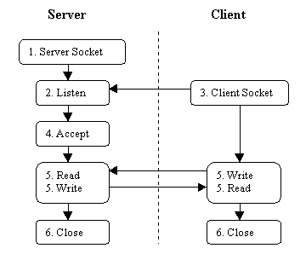
TCP Socket Communication

Slide 12
Sockets Programming in Java
Streams
  The basic of all I/O in Java is the data stream
  A pipeline of data
    put info into the pipeline (write) and get it (read)
Programming with Sockets (TCP)
  Opening a Socket
  Creating a data input stream
  Creating a data output stream
  Closing the socket(s)

Slide 13
Opening a socket
Client-side:
Socket myClient = null;
  try {
  MyClient = new Socket(“host”, PotNumber);
  } catch (UnknownHostException uhe) {
  uhe.printStackTrace();
  }
“host” can be symbolic name or IP address

Slide 14
Opening a socket
Server-side
ServerSocket myService = null;
try {
myService = new ServerSocket(portNumber);
} catch (UnknownHostException uhe) {
uhe.printStackTrace();
}
Socket serviceSocket;
serviceSocket = myService.accept();

Slide 15
Creating an input stream
Client-side:
BufferedReader is = null;
try {
is = new BufferedReader(new
InputStreamReader(myClient.getInputStream()));
} catch (IOException ioe) {
ioe.printStackTrace();
}

Slide 16
Creating an input stream
Server-side:
BufferedReader is = null;
try {
is = new BufferedReader(new
InputStreamReader(serviceClient.getInputStream()));
} catch(IOException ioe) {
ioe.printStackTrace();
}

Slide 17
Creating an output stream
Client-side:
DataOutputStream os = null;
try {
os = new
DataOutputStream(myClient.getOutputStream());
} catch (IOException e) {
e.printStrackTrace();
}

Slide 18
Creating an output stream
Server-side:
DataOutputStream os = null;
try {
os = new
DataOutputStream(serviceClient.getOutputStream());
} catch(IOException e) {
e.printStackTrace();
}

Slide 19
Closing sockets
Client-side:
try {
os.close();
is.close();
myClient.close();
} catch(IOException e) {
e.printStrackTrace();
}

Slide 20
Closing sockets
Server-side:
try {
os.close();
is.close();
serviceSocket.close();
myService.close();
} catch(IOException e) {
e.printStackTrace();
}

Slide 21
Ports
It should be noted that once the server program execution is started, it is not possible for any other server program to run on the same port until the first program which is successful using it is terminated.
Port numbers are a mutually exclusive resource. They cannot be shared among different processes at the same time.

Slide 22
Find Out What Ports Are Listening in Linux
sudo netstat -ltup
sudo ss -lntu
sudo lsof -i
More at https://www.tecmint.com/find-listening-ports-linux/

Slide 23
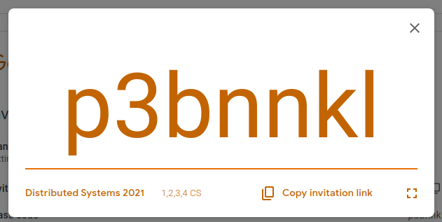

Slide 24
UDP Socket programming
UDP is simple and efficient, but not reliable
Communication takes place in a symmetric manner: both ends send and receive messages following an agreed upon protocol

Slide 25
UDP Socket Programming
Since no connection is created, each message should contain the address of the recipient.
In Java, messages are contained in instances of class DatagramPacket

Slide 26
The DatagramPacket class
Constructors:
  One for sending datagrams:
  DatagramPacket{byte buffer[], int length, InetAddress, int port}
  One for receiving datagrams:
  DatagramPacket{byte buffer[], int length}

Slide 27
The DatagramPacket class
The useful methods are the accessors:
InetAddress getAddress()
Int getPort()
Byte[] getData()
Int getLength()

Slide 28
Sending and receiving Datagram packets: using sockets
Both ends need to create sockets to communicate
Sockets will be “bound” to a given host and port number
The receiver needs to “listen” on a port number that is known by the sender
The sender can a priori use any port number

Slide 29
The DatagramSocket class
Constructors:
  One for the sender (randomly chosen port number):
  DatagramSocket() throws SocketException
  One for the receiver (port needs to be specified):
  DatagramSocket(int port) throws SocketException

Slide 30
The DatagramSocket class
Sending and receiving messages:
void send(DatagramPacket packet) throws IOException
void receive(DatagramPacket packet) throws IOException
Close the socket when you’re done!
void close()

Slide 31
Receiving UDP packets
DatagramSocket socket = new DatagramSocket(port);
Byte buffer[] = new byte[65508];
DatagramPacket packet = new DatagramPacket(buffer, buffer.length);
Socket.receive(packet);
InetAddress fromAddress = packet.getAddress();
int fromPort = packet.getPort();
int length = packet.getLength();
byte[] data = packet.getData();
socket.close();

Slide 32
Sending UDP Packets
DatagramSocket socket = new DatagramSocket();
DatagramPacket packet = new DatagramPacket(data, data.length, InetAddress.getByName(“eureka.sce.carleton.ca”), 1728);
socket.send(packet);
socket.close();

Slide 33
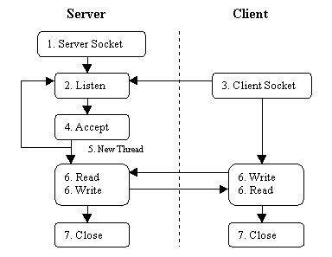
Multi-threaded Servers
A server should be able to serve multiple clients simultaneously

